Slide 1
Random Graph

Slide 2
Overview
Introduction
The random network model
Number of links
Degree distribution
Real networks are not Poisson
Evolution of a random network
Real networks are supercritical

Slide 3
Overview
Introduction
The random network model
Number of links
Degree distribution
Real networks are not Poisson
Evolution of a random network
Real networks are supercritical

Slide 4

From a Cocktail Party to Random Networks
Early: Isolated groups
Later: Single Network
Information spread in a cocktail party.

Slide 5
Overview
Introduction
The random network model
Number of links
Degree distribution
Real networks are not Poisson
Evolution of a random network
Real networks are supercritical

Slide 6









Random Graph Model
In a sequence of papers between 1959 and 1968, Erdös and Rényi established random graph theory, by combining probability theory with graph theory.
Pál Erdös
(1913-1996)
Alfréd Rényi
(1921-1970)
Erdös-Rényi model (1960)
Idea: Connect nodes with probability 𝒑
1
Left: An example of a random network with 𝑝 = ₆ , 𝑁 = 10.

Slide 7
Random Graph Model (Cont.)
Definition: A random graph or a random network is a graph of 𝑁 nodes where
each pair of nodes is connected by probability 𝑝.
Historically, there were two formulations of a random network:
𝐺 𝑁, 𝐿 model: 𝑁 labeled nodes are connected with 𝐿 randomly placed links. Erdös and Rényi used this definition in their string of papers on random networks.
𝐺(𝑁, 𝑝) model: Each pair of 𝑁 labeled nodes is connected with probability
𝑝, a model introduced by Gilbert.
Both 𝐺(𝑁,𝐿) model and 𝐺(𝑁,𝑝) model provide good descriptions of random networks.
The 𝐺(𝑁,𝑝) model yields more flexibility in analysis and from here on we will
mostly focus on this model.

Slide 8




Random Graph Model Examples
1
Examples of random networks with 𝑝 = ₆ 𝑁 = 12
𝐿 = 11
𝐿 = 10
𝐿 = 8

Slide 9
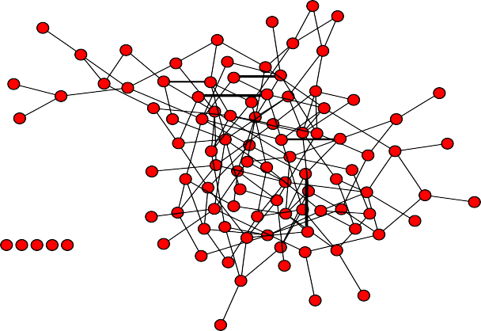
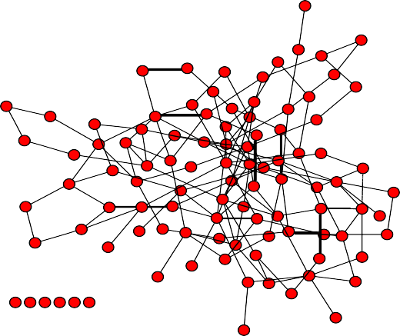
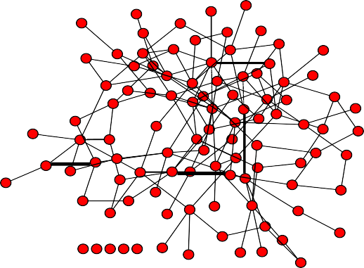
Random Graph Model Examples (Cont.)
Examples of random networks with 𝑝 = 0.03 𝑁 = 100
Do these examples look like real networks?

Slide 10
Overview
Introduction
The random network model
Number of links
Degree distribution
Real networks are not Poisson
Evolution of a random network
Real networks are supercritical

Slide 11
Random Graph Model Example
1
Examples of random networks with 𝑝 = ₆ 𝑁 = 12
𝐿 = 11
𝐿 = 10 𝐿 = 8
Observation: Random networks have different links (positions and numbers) despite having the same parameters.
11

Slide 12



Number of Links in a Random Graph
𝑷(𝑳): the probability of having 𝐿 links in a network of 𝑁 nodes and probability 𝑝
of linking pairs of nodes:
The maximum number of links in a network of 𝑁 nodes.
𝑁 2
𝐿
𝑁 𝑁−1 _{−𝐿}
𝑃 𝐿 =
𝐿
𝑝 1 − 𝑝
2
Binomial distribution
Probability of not forming 𝑁 − 𝐿
links in a network of 𝑁 nodes.
Number of different ways we can choose
𝐿 links among all potential links.
Probability of forming 𝐿 links in a network of 𝑁 nodes.

Slide 13
Binomial Distribution Review
Binomial distribution is the discrete probability distribution of the number of successes in a sequence of 𝑁 independent experiments:
𝑃 𝑥 = ^{𝑁} 𝑝^{𝑥} 1 − 𝑝 ^{𝑁−𝑥} .
𝑥
Then
𝑥 = 𝑁𝑝
_{𝑥}2
= 𝑝 1 − 𝑝 𝑁 + 𝑝²𝑁²
𝜎_{𝑥} =
_{𝑘}2
− 𝑘 ^{2 1/2} = 𝑝 1 − 𝑝 𝑁 ^{1/2}
and 𝑥² = E 𝑥² .
Here 𝑥 = E 𝑥

Slide 14
Random Graph Model
𝑷(𝑳): the probability to have a network of 𝐿 links
𝑁 2
𝐿
𝑁 𝑁−1 _{−𝐿}
𝑃 𝐿 =
𝐿
𝑝 1 − 𝑝
2
The mean number 𝐿 of links in a random graph
𝑁 𝑁−1 2
𝐿 = ෍ 𝐿𝑃 𝐿 = 𝑝
𝐿=0
𝑁 𝑁 − 1
2
The variance of number of links
𝜎² = 𝑝 1 − 𝑝 ^{𝑁 𝑁 − 1}
2

Slide 15
Overview
Introduction
The random network model
Number of links
Degree distribution
Real networks are not Poisson
Evolution of a random network
Real networks are supercritical

Slide 16
Degree Distribution of a Random Graph
The probability that a node has degree 𝑘
𝑃 𝑘 = ^{𝑁 − 1} 𝑝^{𝑘} 1 − 𝑝
𝑁−1 −𝑘
𝑘
select 𝑘
nodes from 𝑁 − 1
probability of having 𝑘 edges
probability of missing 𝑁 − 1 − 𝑘
edges
In a random network the probability that a node has degree 𝑘 is the product
of three terms:
The number of ways we can select 𝑘 links from 𝑁−1 potential links;
The probability that 𝑘 of its links are present, 𝑝^{𝑘};
The probability that 𝑁 − 1 − 𝑘 of its links are missing, 1 − 𝑝
𝑁−1 −𝑘.

Slide 17
Degree Distribution of a Random Graph (Cont.)
The probability that a node has degree 𝑘
𝑃 𝑘 = ^{𝑁 − 1} 𝑝^{𝑘} 1 − 𝑝
𝑁−1 −𝑘
𝑘
which is a Binomial distribution.
The average number of degrees 𝑘 in a random graph is 𝑘 = 𝑝 𝑁 − 1 . The variance of degrees 𝜎² in a random graph is 𝜎² = 𝑝(1 − 𝑝)(𝑁 − 1).
𝑘 𝑘
The coefficient of variation 𝜎_{𝑘}/ 𝑘 is
𝜎_{𝑘} 1 − 𝑝 1
1/2
1
_{𝑘} =
𝑝 𝑁 − 1 ≈ (𝑁 − 1)^{1/2}
As the network size 𝑁 increases, the distribution becomes increasingly narrow—we
are increasingly confident that the degree of a node is in the neighborhood of 𝑘 .

Slide 18



Poisson Degree Distribution
The exact degree distribution is given as the Binomial distribution:
𝑘
𝑃 𝑘 = ^{𝑁 − 1} 𝑝^{𝑘} 1 − 𝑝
𝑁−1 −𝑘
𝑘 = 𝑝 𝑁 − 1 𝑝 =
𝑘
𝑁 − 1
For large 𝑁 and small 𝑘 (𝑁 ≫ 𝑘 ), the Binomial distribution is well approximated by
the Poisson distribution:
_{𝑘} 𝑘
𝑃 𝑘 = 𝑒
− 𝑘
𝑘!
The Poisson distribution is preferred in calculations due to its simplicity:
The Binomial distribution depends on two parameters, 𝑝 and 𝑁;
The Poisson distribution depends on only one parameter, 𝑘 .
In the remainder of this course, we will use only the Poisson distribution as the
degree distribution of a random network.

Slide 19
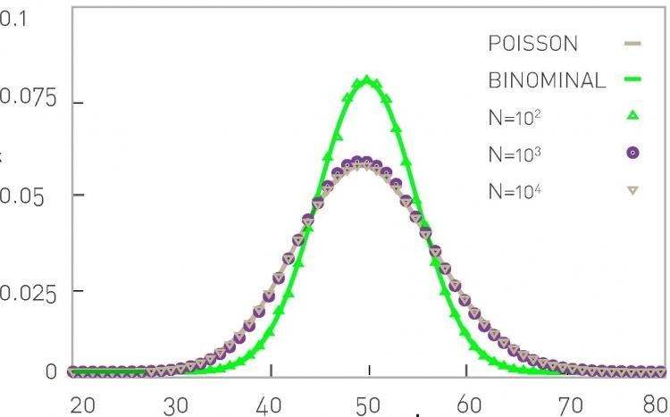
Binomial Distribution vs. Poisson Distribution
Probability Distribution Function (PDF)
Degree 𝑘
Degree distributions using Poisson and Binomial distributions with < 𝑘 >= 50.

Slide 20
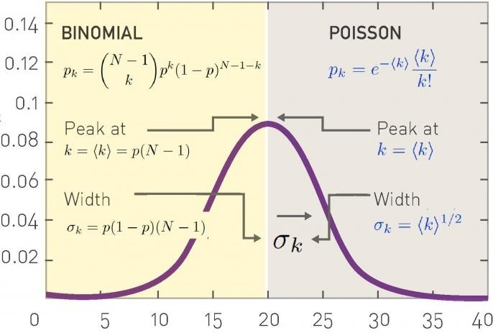
Binomial Distribution vs. Poisson Distribution (Cont.)
Exact Result
-binomial distribution-
Large 𝑵 limit
-Poisson distribution-
Probability Distribution Function (PDF)
Degree 𝑘
20

Slide 21
Comments on Poisson Distribution
The Poisson distribution is an approximate form of the degree distribution. The exact form is the Binomial distribution.
This approximation is exact only when 𝑁 ≫ 𝑘 . As most networks are sparse, this assumption is generally correct.
The advantage of the Poisson distribution is its simplicity in calculations.
The Poisson distribution does not explicitly depend on the number of nodes
𝑁. So it predicts that large networks (𝑁 ≫ 𝑘 ) have similar degree
distributions.

Slide 22
Overview
Introduction
The random network model
Number of links
Degree distribution
Real networks are not Poisson
Evolution of a random network
Real networks are supercritical

Slide 23
Maximum and Minimum Degrees
Suppose we are considering a random society with 𝑁 = 10⁹ individuals and
average degree 𝑘 = 1000.
We roughly estimate the values of the maximum degree 𝑘_{max} and minimum
degree 𝑘_{min} as values satisfying 𝑃 𝑘 > 𝑘_{max}
Then we would have
1 1
≤ _{𝑁} and 𝑃(𝑘 < 𝑘_{min}) ≤ _{𝑁}.
𝑘_{max} = 1185 𝑘_{min} = 816
Would these parameters correspond well with real social networks?

Slide 24

No Outliers in a Random Society
In a random society with the degree distribution following the Poisson distribution
_{𝑘} 𝑘
𝑃 𝑘 = 𝑒
− 𝑘
𝑘!
The most connected individual has degree 𝑘_{max}~1,185.
The least connected individual has degree 𝑘_{min} ~ 816.
The probability to find an individual with degree 𝑘 > 2000 is 10⁻²⁷. Hence the chance of finding an individual with 2,000 acquaintances is so tiny that such nodes are virtually non-existent in a random society.
A random society would consist of mainly average connected individuals, with
everyone with roughly the same number of friends.
It would lack outliers, individuals that are either highly popular or recluse.
Are these the patterns we expect in a real social network? What about other real networks?
24

Slide 25
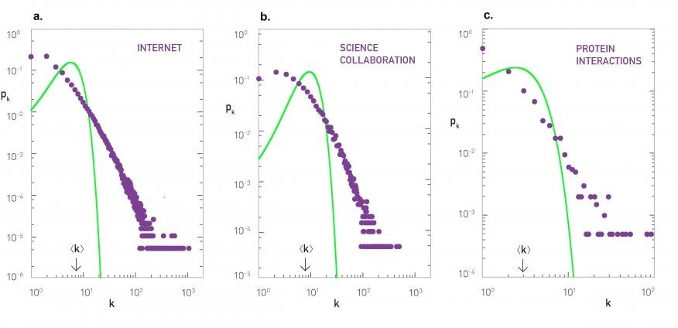
FACING REALITY: Degree Distribution of Real Networks
Poisson distributions (green line) versus real degree distributions (purple dots) for three
real networks.
Observation: Many real networks have outliers that are not represented by the Poisson
distribution.
25

Slide 26
Overview
Introduction
The random network model
Number of links
Degree distribution
Real networks are not Poisson
Evolution of a random network
Real networks are supercritical

Slide 27
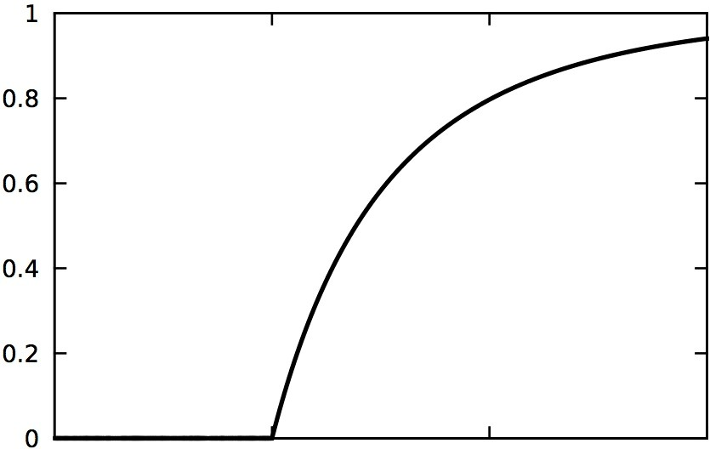
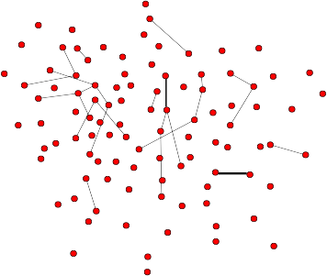
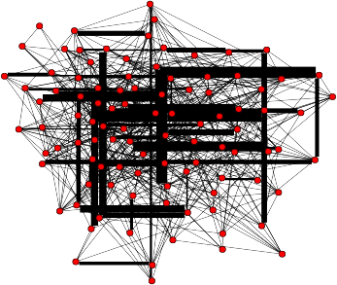
Evolution of a Random Graph
mostly disconnected nodes ➔ increasingly connected network
Fraction of nodes in the largest component
Average degree 𝑘
In a random network, there is a clear transition between disconnected
nodes and a network with increasing average degree.
How does this transition happen?

Slide 28
Evolution of a Random Graph (Cont.)
One would expect that the size of largest component 𝑁_{𝐺} grows gradually from
𝑁_{G} = 1 to 𝑁_{G} = 𝑁 if 𝑘 increases from 0 to 𝑁 − 1.
Yet, as the previous slide shows, this is not the case:
𝑁_{𝐺} /𝑁 remains zero for small 𝑘 , indicating the lack of a large component;
Once 𝑘 exceeds a critical value, 𝑁_{𝐺} /𝑁 increases rapidly, signaling the rapid emergence of a giant component (a component consisting of a meaningful finite fraction of nodes).
Erdős and Rényi in their classical 1959 paper predicted that the condition for the emergence of the giant component is
𝑘 = 1.
In other words, we have a giant component if and only if each node has on average more than one link.
This also means that few nodes have no connections.
28

Slide 29
Evolution of a Random Graph (Cont.)
The fact that at least one link per node is necessary to have a giant component is not unexpected. Indeed, for a giant component to exist, each of its nodes must be linked to at least one other node.
But it is somewhat unexpected that one link is sufficient for the emergence of a giant component.
It is equally interesting that the emergence of the giant component is not gradual, but follows what physicists call a second-order phase transition at 𝑘 = 1.
If we roughly express the condition 𝑘 = 1 in terms of the probability of connection
(between a pair of nodes), we have
𝑘
𝑝 =
≈ ¹ .
c
𝑁 − 1 𝑁
Namely, the larger a network, the smaller 𝑝 is sufficient for the giant component.

Slide 30
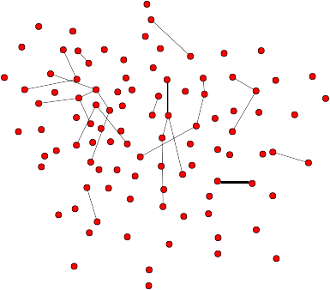
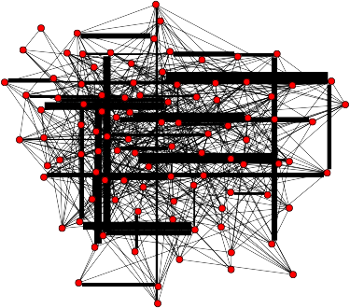
Evolution of a Random Graph (Cont.)
mostly disconnected nodes ➔ increasingly connected network
Fraction of nodes in the largest component 𝑁_{G}/𝑁
Average Degree 𝑘
We now know there is a phase transition (as in physics). Could there be more
transitions?

Slide 31
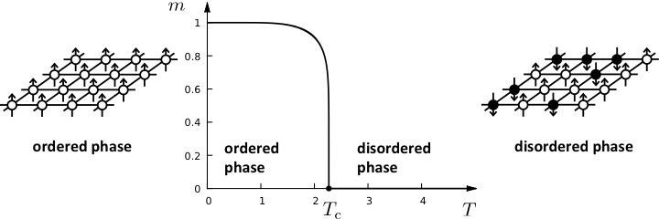
Phase Transitions in Complex Systems I: Magnetism
Phase transition in magnetism: materials gain magnetism (ordered) when
cooled below the critical temperature 𝑇_{c} and lose magnetism (disordered) when
heated above 𝑇_{c}.
31

Slide 32
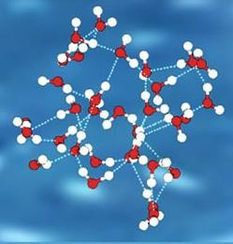
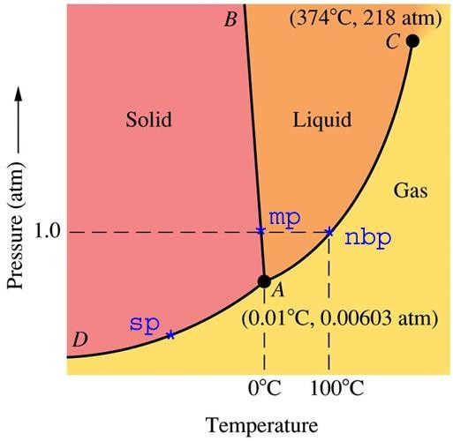
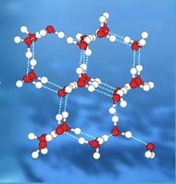
Phase Transitions in Complex Systems II: Liquid
Water Ice
Phase transition in liquid: liquid changes states with changes in temperature and pressure. The three states show different strength of order: solid is most ordered, gas is most disordered, and water is in between.
32

Slide 33
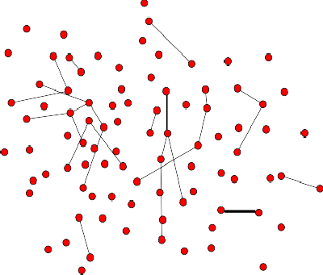
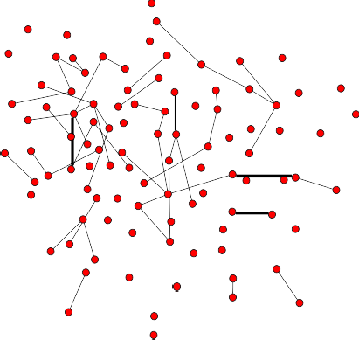
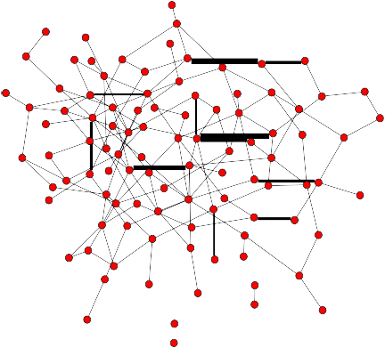
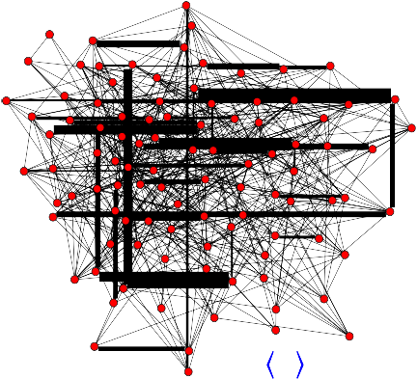
Phase Transitions in Random Networks
I:
Subcritical
𝑘 < 1
II:
Critical
𝑘 = 1
III:
Supercritical
𝑘 > 1
IV:
Connected
𝑘 > ln 𝑁
𝑵 = 𝟏𝟎𝟎
33
𝒌 = 𝟓
𝒌 = 𝟎. 𝟓
𝒌 = 𝟏
𝒌 = 𝟑

Slide 34
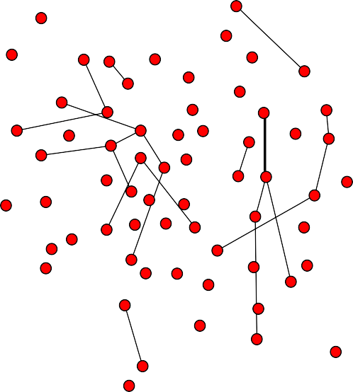



Subcritical
𝑘 < 1
I:
𝑁_{G}/𝑁
𝑝 < 𝑝_{c} = 1/𝑁
𝑘 = 𝟎. 𝟓
𝑘
In the subcritical regime, there is no giant component.
Approximately 𝑁 − 𝐿 isolated components. Most components are composed of pairs of nodes.
The largest cluster is a tree, its size 𝑁_{G}~ ln 𝑁 (can be derived) and 𝑁_{G}/𝑁 → 0 as 𝑁 → ∞.34

Slide 35
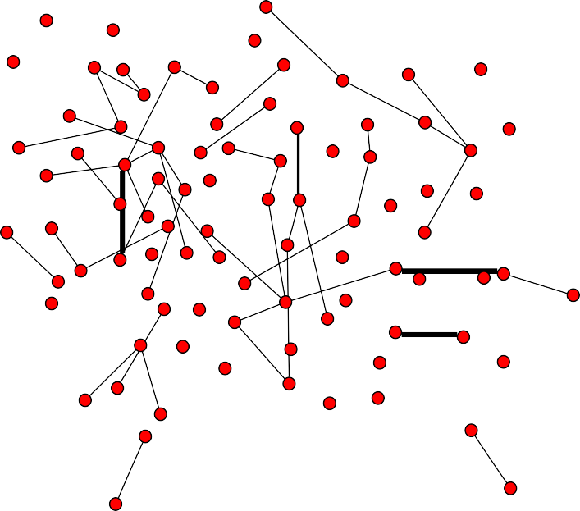
Critical
𝑘 = 1
II:
𝑁_{G}/𝑁
𝑝 = 𝑝_{c} = 1/𝑁
𝑘 = 𝟏
𝑘
In the critical point, single giant component: 𝑁_{G}~ 𝑁^{2/3} (can be derived):
GC contains a vanishing fraction of all nodes, 𝑁_{G}/𝑁~𝑁^{−1/3};
Small components are trees, GC has loops.
The size of the giant component jumps in this phase:
For 𝑁 = 1000: in the subcritical phase 𝑁_{G}~6.9, but in the critical phase 𝑁_{G}~95.
35

Slide 36


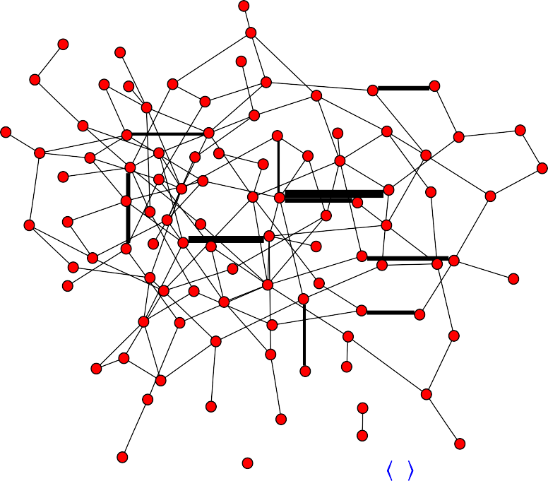
III:
Supercritical
𝑁_{G}/𝑁
𝑘 > 1
𝑝 > 𝑝_{𝑐} = 1/𝑁
𝑘 = 𝟑
𝑘
In the supercritical regime, single giant component: 𝑁_{G}~ (𝑝 − 𝑝_{c})𝑁 (can be derived)
GC has loops.
GC looks like a real network (will discuss later).
Numerous isolated small components coexist with the giant component.
This phase ends when all small components are absorbed into the giant component.
36

Slide 37
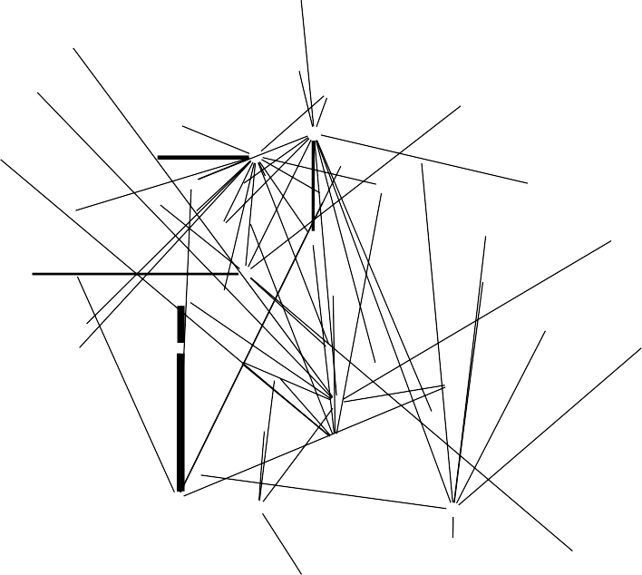













Connected
𝑘 > ln 𝑁
IV:
𝑁_{G}/𝑁
𝑝 > (ln 𝑁)/𝑁
𝑘 = 𝟓
𝑘
In the connected regime, only one component: 𝑁_{G} = 𝑁 (can be derived):
All nodes and components are absorbed into GC;
The network is densely connected.
No nodes are isolated. No small component exists.

Slide 38
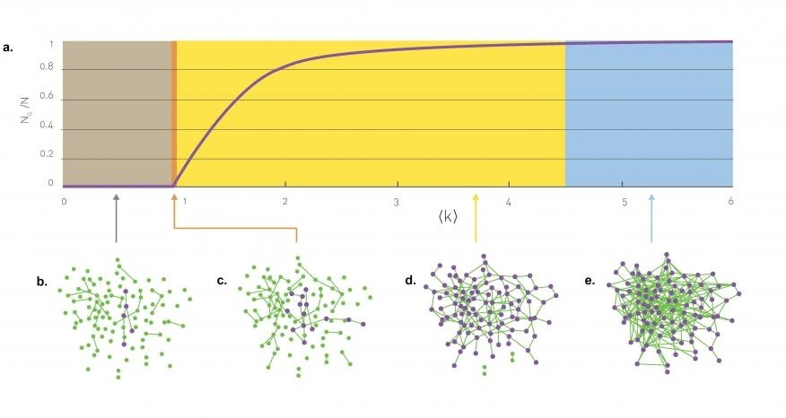
Phase Transitions in Random Graphs
Subcritical
Critical
Supercritical
Connected

Slide 39
Remarks
The random network model predicts that the emergence of a
network is not a smooth, gradual process.
The isolated nodes and tiny components observed for small
𝑘 collapse into a giant component through a phase
transition.
As we vary 𝑘
regimes.
we encounter four topologically distinct
The giant component in the supercritical phase looks like a real network (see later).

Slide 40
Overview
Introduction
The random network model
Number of links
Degree distribution
Real networks are not Poisson
Evolution of a random network
Real networks are supercritical

Slide 41
Predictions of Random Graph Theory
Once the average degree exceeds 𝑘 = 1 (critical), a giant component should emerge that contains a meaningful finite fraction of all nodes.
Hence only for 𝑘 > 1 (supercritical) the nodes organize
themselves into a recognizable network.
For 𝑘 > ln 𝑁 (connected) all components are absorbed by the giant component, resulting in a single connected network.
But do real networks satisfy these properties?

Slide 42
Most Real Networks are Supercritical
Network | 𝑁 | 𝐿 | < 𝑘 > | ln 𝑵
Internet | 192,244 | 609,066 | 6.34 | 12.17
Power Grid | 4,94 | 6,594 | 2.67 | 8.51
Science Collaboration | 23,133 | 94,437 | 8.08 | 10.05
Actor Network | 702,388 | 29,397,908 | 83.71 | 13.46
Protein Interactions | 2,018 | 2,930 | 2.90 | 7.61
These measurements indicate that real networks significantly exceed the 𝑘 = 1
threshold.
Based on the random network theory, all these real networks should contain a giant
component.
These measurements also show that real networks are below the 𝑘 = ln 𝑁
threshold.
Based on the random network theory, all these real networks should be fragmented
into multiple components.
42

Slide 43


Most Real Networks are Supercritical (Cont.)
NETWORK | NODES | LINKS | DIRECTED UNDIRECTED | 𝑵 | 𝑳 | 𝒌
Internet | Routers | Internet connections | Undirected | 192,244 | 609,066 | 6.33
WWW | Webpages | URL links | Directed | 325,729 | 1,497,134 | 4.60
Power Grid | Power plants, transformers | Cables | Undirected | 4,941 | 6,594 | 2.67
Mobile Phone Calls | Subscribers | Calls | Directed | 36,595 | 91,826 | 2.51
Email | Email addresses | Emails | Directed | 57,194 | 103,731 | 1.81
Science Collaboration | Scientists | Co-authorship | Undirected | 23,133 | 93,439 | 8.08
Actor Network | Actors | Co-acting | Undirected | 702,388 | 29,397,908 | 83.71
Citation Network | Papers | Citations | Directed | 449,673 | 4,689,479 | 10.43
E. Coli Metabolism | Metabolites | Chemical reactions | Directed | 1,039 | 5,802 | 5.58
Protein Interactions | Proteins | Binding interactions | Undirected | 2,018 | 2,930 | 2.90
Observation: Most real networks are supercritical (1 < 𝑘 < ln 𝑁).
43

Slide 44

Most Real Networks are Supercritical (Cont.)
The crosses (X) indicate the locations of 𝑘 .
The diagram indicates that most networks are in the supercritical regime
(1 < 𝑘 < ln 𝑘).
Only the actor network is in the connected regime.
44

